Slide 1
Rocket Launch Simulation
By: Robert Bosh & Levi Wilson
Assisted By: Dr. Gordon Emslie

Slide 2
Terms Used In Rocket Calculations
deltaT
Interval at which we calculate the DeltaV of the rocket. Smaller the deltaT, the more precise the calculation. (s)
t
Time after launch, assuming at time 0 is immediately when the rocket begins to exert an upward thrust. (s)
r
Radius of a stage of the rocket. When it used to find lateral surface area, the largest stage still attached is used. (m)
height
Height of a stage of the rocket. Radius and height are used to find volume, which is used to find mass. (m)

Slide 3
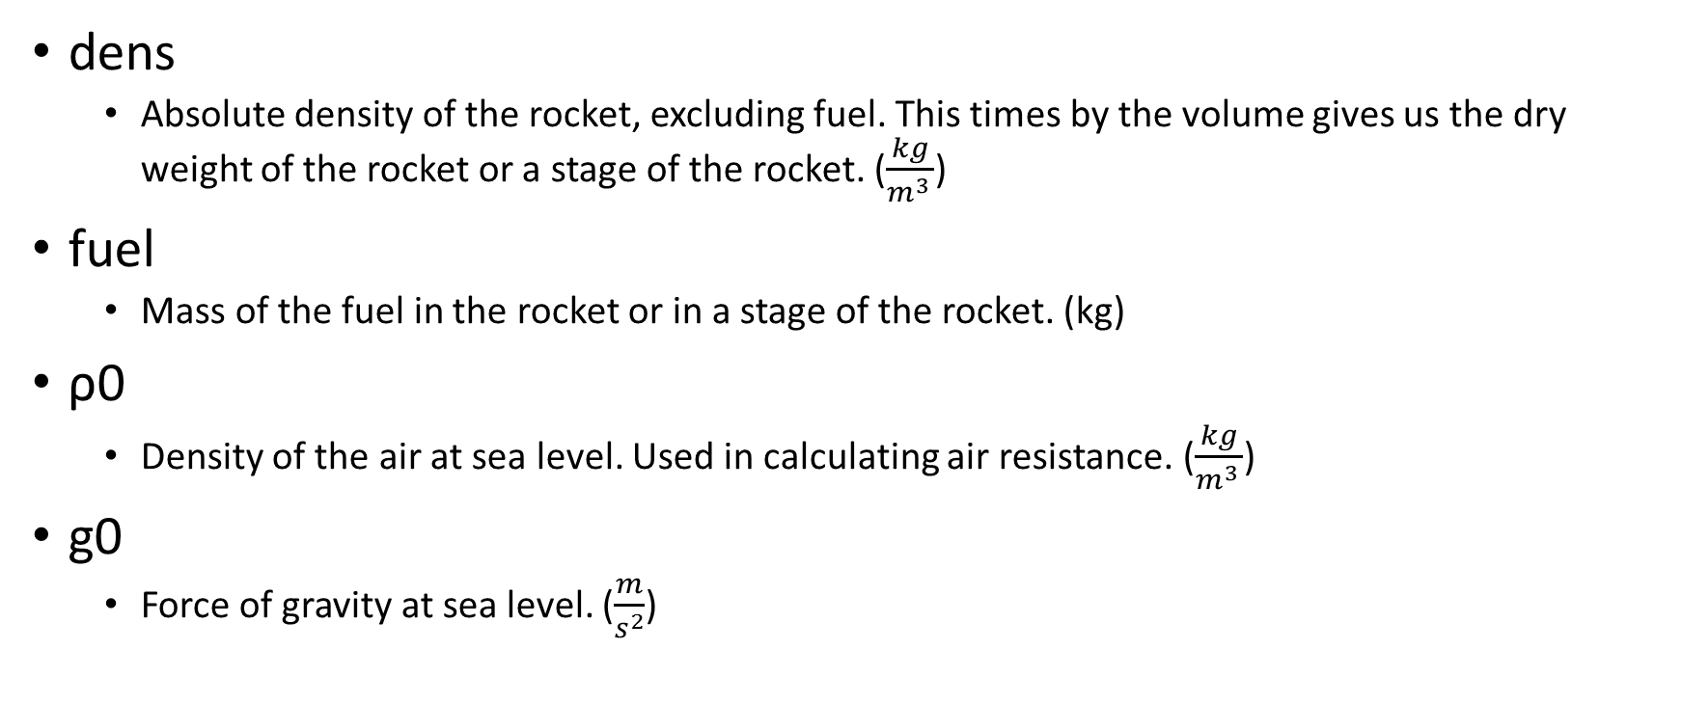
Terms Used (cont’d)
dens
Absolute density of the rocket, excluding fuel. This times by the volume gives us the dry weight of the rocket or a stage of the rocket. ($\frac{kg}{m^{3 }}$)
fuel
Mass of the fuel in the rocket or in a stage of the rocket. (kg)
ρ0
Density of the air at sea level. Used in calculating air resistance. ($\frac{kg}{m^{3 }}$)
g0
Force of gravity at sea level. ($\frac{m}{s^{2}}$)

Slide 4
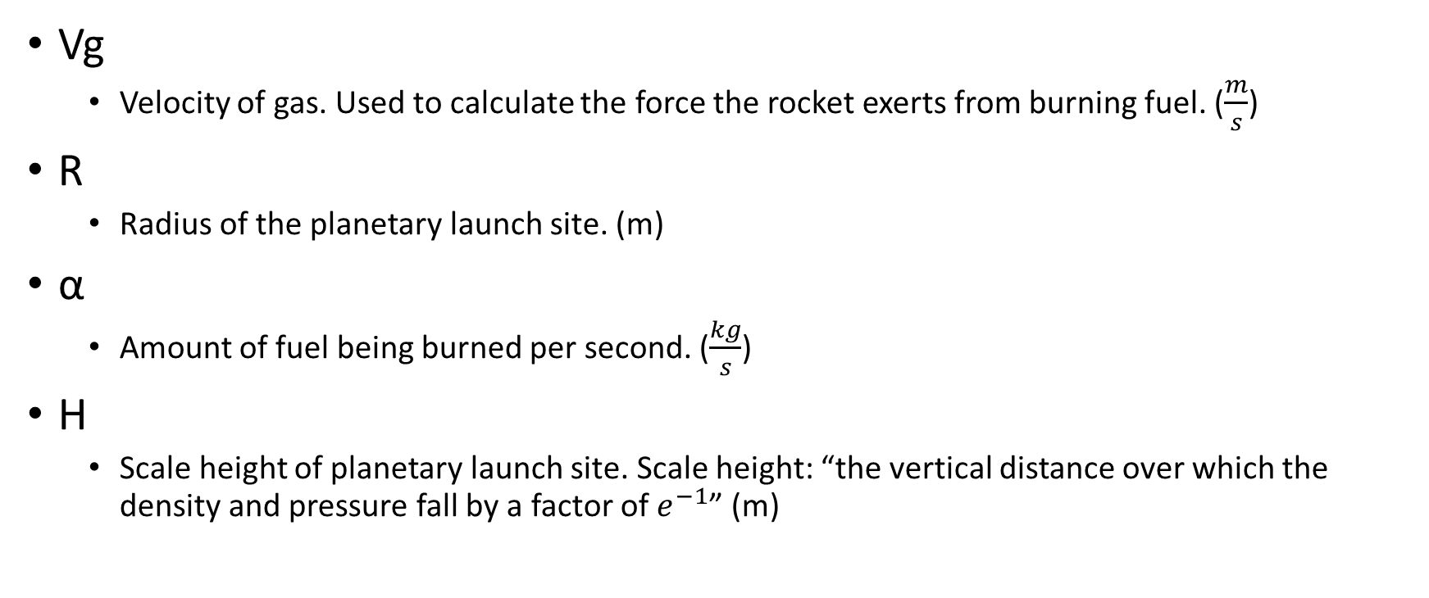
Terms Used (cont’d)
Vg
Velocity of gas. Used to calculate the force the rocket exerts from burning fuel. ($\frac{m}{s}$)
R
Radius of the planetary launch site. (m)
α
Amount of fuel being burned per second. ($\frac{kg}{s}$)
H
Scale height of planetary launch site. Scale height: “the vertical distance over which the density and pressure fall by a factor of $e^{−1}$” (m)

Slide 5
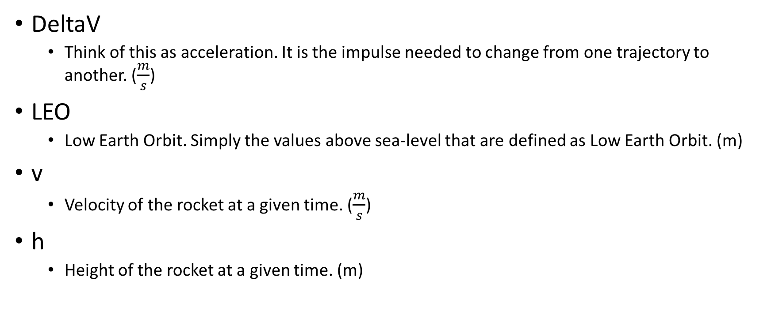
Terms Used (cont’d)
DeltaV
Think of this as acceleration. It is the impulse needed to change from one trajectory to another. ($\frac{m}{s}$)
LEO
Low Earth Orbit. Simply the values above sea-level that are defined as Low Earth Orbit. (m)
v
Velocity of the rocket at a given time. ($\frac{m}{s}$)
h
Height of the rocket at a given time. (m)

